Slide 1
Systems Analysis
Information Systems 622
IS622, chapter 5
Mr N. Mathenjwa

Slide 2
Learning Objectives
Identify the key participants in the systems development process and discuss their roles.
Define the term ‘information systems’ ,‘planning’ and list several reasons for initiating a systems project.
Discuss three trends that illustrate the impact of enterprise resource planning software packages on systems development.
Discuss the key features, advantages and disadvantages of the traditional, prototyping, rapid application development and end-user systems development lifecycles.
Identify several factors that influence the success or failure of a systems development project.
Discuss the use of CASE tools and the object-oriented approach to systems development.
State the purpose of systems investigation.
Discuss the importance of performance and cost objectives.
State the purpose of systems analysis and discuss some of the tools and techniques used in this phase of systems development.

Slide 3
1.1 Introduction
Throughout the guide you have seen many examples of the use of information systems. But where do these systems come from? How can you work with IS personnel such as systems analysts and computer programmers to get what you need to succeed on the job? This chapter gives you the answer.

Slide 4
An Overview of Systems Development
Because business information systems are central to project success, users are helping with development and, in many cases, leading the way. Users might request that a systems development team determine whether they should purchase a few PCs, update an existing order processing system, develop a new medical diagnostic or design and implement a new website.
In other cases, systems development might involve purchasing or leasing a system such as an enterprise resource planning (ERP) package. This chapter and the next provide you with a deeper appreciation of the systems development process and show how businesses can avoid costly failures.

Slide 5
Participants in Systems Development
Active systems development requires a team effort. The team usually consists of users, managers, systems development specialists, various support personnel and other stakeholders.

Slide 6
Table 5.1 Typical Reasons to Initiate a Systems Development Project
Notes:
M-commerce (mobile commerce) is the buying and selling of goods and services through wireless handheld devices such as smartphones and tablets. As a form of e-commerce, m-commerce enables users to access online shopping platforms without needing to use a desktop computer

Slide 7
5.2 Systems Development Lifecycles
The systems development process is also called the ‘systems development lifecycle’ (SDLC) be- cause the activities associated with it are ongoing. As each system is built, the project has timelines and deadlines, until the system is installed and accepted.
Figure 5.3 Relationship Between Timing of Errors and Costs

Slide 8
Systems Development Lifecycles
Several common systems development lifecycles exist: the traditional or waterfall approach, prototyping, rapid application development (RAD) and end-user development. In addition, companies can outsource the systems development process. With many companies and most public sector organizations, these approaches are formalized and documented so that systems developers have a well-defined process to follow;
Keep Figure 5.3 in mind as you are introduced to alternative SDLCs in the sections that follow.

Slide 9
Systems Development Lifecycles
The Traditional Systems Development Lifecycle:
Traditional systems development efforts can range from a small project, such as purchasing an inexpensive computer program, to a major undertaking. The steps of traditional systems development might vary from one company to the next, but most approaches have five common phases: investigation, analysis, design, implementation, and maintenance and review.

Slide 10
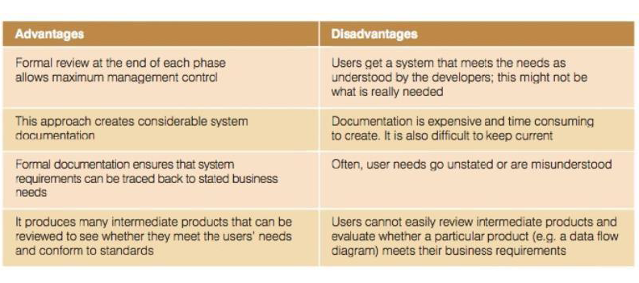
Systems Development Lifecycles
The Traditional Systems Development Lifecycle:

Slide 11
Systems Development Lifecycles
Prototyping :
Prototyping, also known as the evolutionary lifecycle, takes an iterative approach to the systems development process. During each iteration, requirements and alternative solutions to the problem are identified and analyzed, new solutions are designed and a portion of the system is implemented. Users are then encouraged to try the prototype and provide feedback (see Figure 5.5). Prototyping begins with creating a preliminary model of a major subsystem or a scaled-down version of the entire system.

Slide 12
Systems Development Lifecycles
Prototyping :

Slide 13
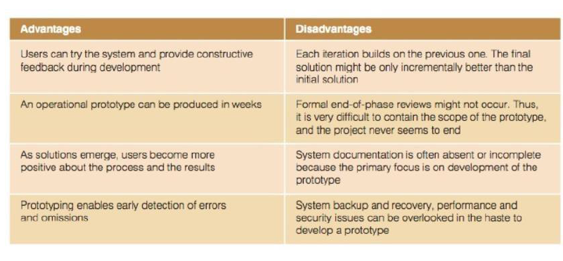
Systems Development Lifecycles
Prototyping :

Slide 14
Systems Development Lifecycles
Rapid Application Development, Agile Development, Joint Application Development and Other Systems Development Approaches
Rapid application development (RAD) employs tools, techniques and methodologies designed to speed up application development.
RAD reduces paper-based documentation, automatically generates program source code and facilitates user participation in design and development activities. It makes adapting to changing system requirements easier.

Slide 15
Systems Development Lifecycles
Rapid Application Development, Agile Development, Joint Application Development and Other Systems Development Approaches:
Other approaches to rapid development, such as agile development, allow the systems to change as they are being developed. Agile development requires frequent face-to-face meetings with the systems developers and users as they modify, refine and test how the system meets user’s needs and what its capabilities are. Some people also consider it to be the same as prototyping.

Slide 16
Systems Development Lifecycles
Rapid Application Development, Agile Development, Joint Application Development and Other Systems Development Approaches:
RAD makes extensive use of the joint application development (JAD) process for data collection and requirements analysis. Originally developed by IBM Canada in the 1970s, JAD involves group meetings in which users, stakeholders and IS professionals work together to analyze existing systems, propose possible solutions and define the requirements of a new or modified system. JAD groups consist of both problem holders and solution providers.

Slide 17
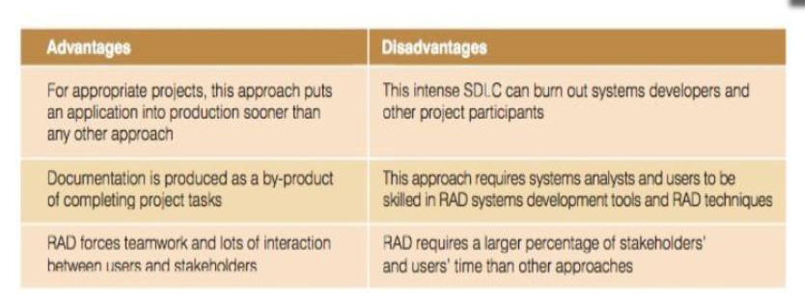
Systems Development Lifecycles
Rapid Application Development:

Slide 18
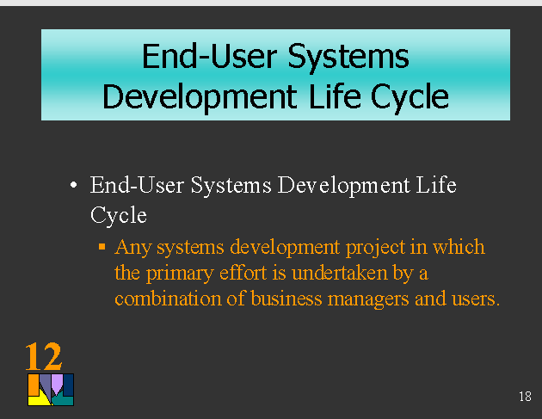
The End-User Systems Development Lifecycle
The term end-user systems development describes any systems development project in which business managers and users assume the primary effort.
Rather than ignoring these initiatives, astute IS professionals encourage them by offering guidance and support.

Slide 19
Outsourcing and On-Demand Computing
Many companies hire an outside consulting firm or computer company that specializes in systems development to take over some or all of its development and operations activities.
Some companies, such as General Electric, have their own outsourcing subunits or have spun off their outsourcing subunits as separate companies.

Slide 20
Outsourcing and On-Demand Computing
Outsourcing can be a good idea under the following circumstances:
When a company believes it can cut costs.
When a firm has limited opportunity to distinguish itself competitively through a particular IS operation or application.
When uninterrupted IS service is not crucial.
When outsourcing does not strip the company of technical know-how required for future IS innovation.
When the firm’s existing IS capabilities are limited, ineffective or technically inferior.
When a firm is downsizing

Slide 21
Outsourcing and On-Demand Computing
Organizations can use a number of guidelines to make outsourcing a success, including the following:
Keep tight controls on the outsourcing project.
Treat outsourcing companies as partners.
Start with smaller outsourcing jobs.
Create effective communications channels between the organization and the outsourcing company.
Carefully review legal outsourcing contracts, including rights and remedies clauses.

Slide 22
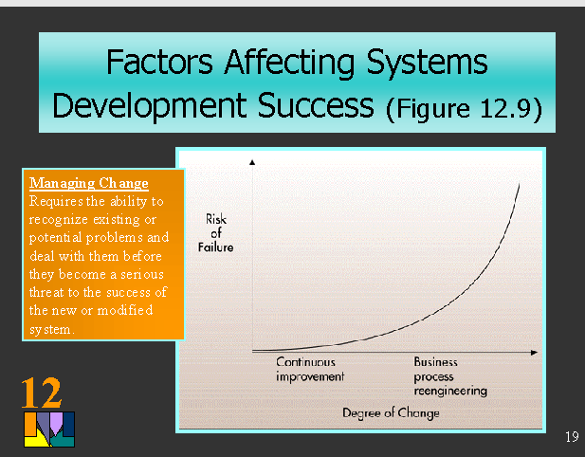
5.3 Factors Affecting System Development Success

Slide 23
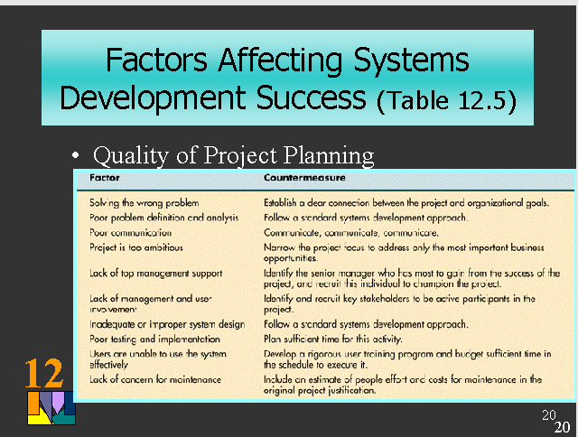
5.3 Factors Affecting System Development Success

Slide 24
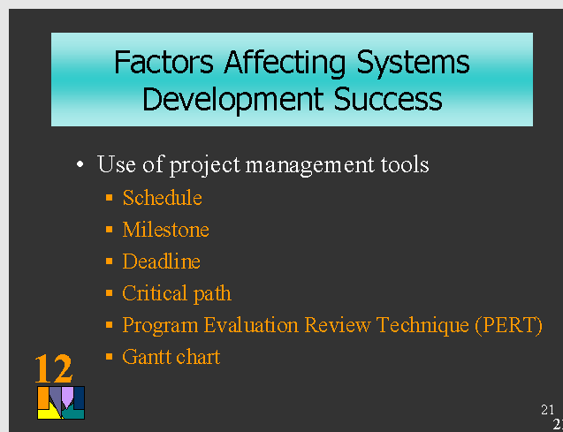
5.3 Factors Affecting System Development Success

Slide 25
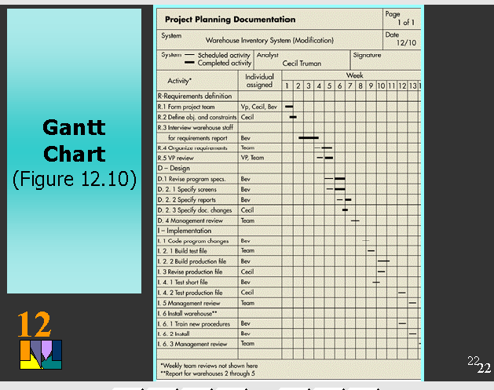
5.3 Factors Affecting System Development Success

Slide 26
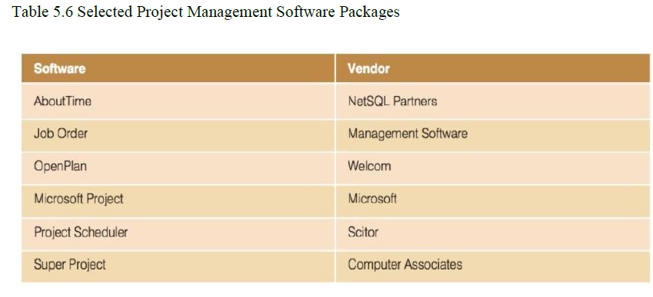

Slide 27
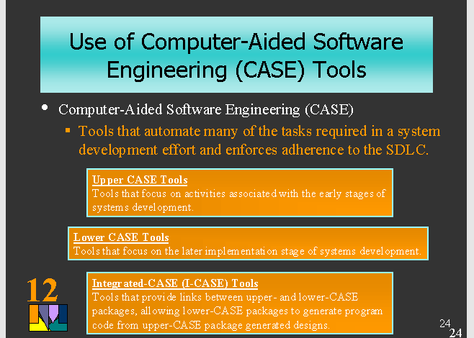

Slide 28
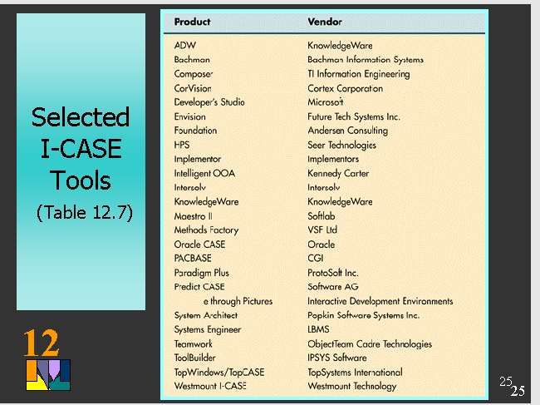

Slide 29
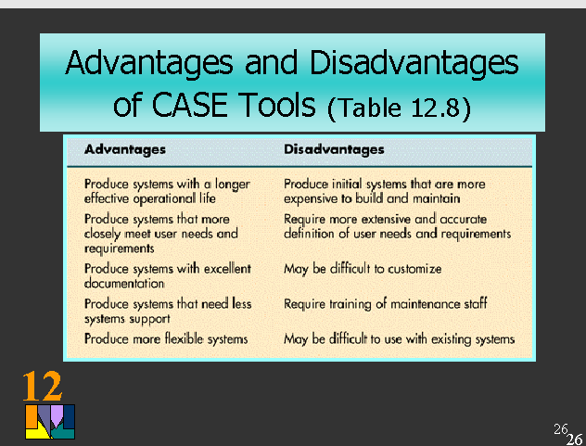

Slide 30
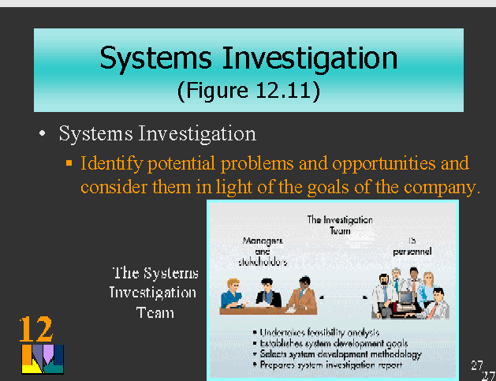

Slide 31
https://github.com/nqubekoh/IS622
The End!!!

